Slide 1
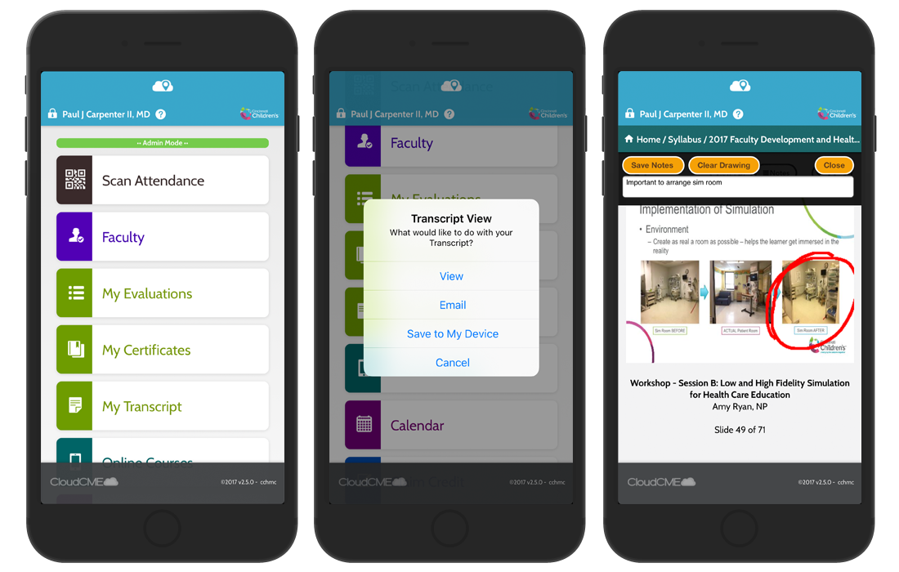
Via CloudCME® Mobile App
CloudCME® Mobile App
Activity Sign in Process
Step 1: Download the CloudCME mobile app (If you have not already done so)
Step 2: Open the App, use Organization code: jefferson
Step 3: Click the Login or Create Account button
Step 4: Select the login option that applies to you
*Jefferson employees should use their Campus Key and password to log in
*Non-Jefferson users should select “All Others”

Slide 2
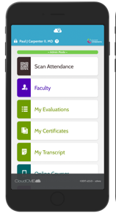
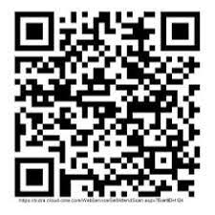
QR Scanning
Activity Sign in Process
Scan the QR code using the ‘Scan Attendance’ button in the CloudCME® mobile app.
*Do not use your mobile camera to scan the code
Insert QR CODE here
Sample

Slide 3
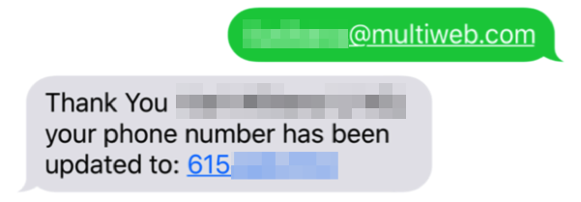
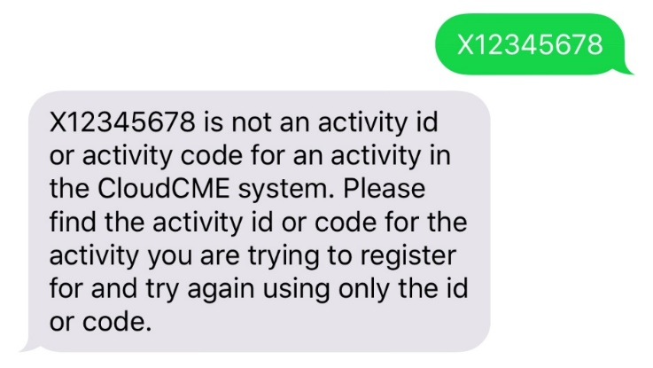
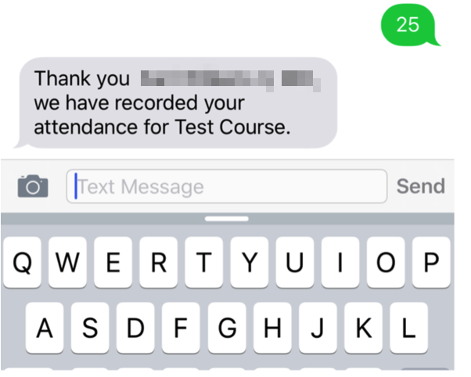
SMS Code
Activity Sign in Process
SMS Texting Instructions
These instructions are intended only for users that have an active account in CloudCME®. Attendance can only be recorded {60 minutes prior to the meeting, during the activity, or within 2 days after the meeting}.
Step 1: Pair your mobile phone to your account in CloudCME®. (ONE TIME ONLY) Organization code: jefferson
Text the email address associated with your account to (844) 986-0352. You MUST use your SSO email if you have one. A message will be sent that looks like the one below.
Step 2: Text the SMS CODE provided, to (844) 986-0352. *Tip: Add the 10 digit number as a contact.
TEXT ACTIVITY CODE
#####
Child ID will be unique for each activity, and only work once. If a user attempts to use an activity code that does not exist, they will receive the following message.

